Slide 1
Non-Euclidean Game Engine
Project Members
Ozan Bayraktar
Ömer Buğra İnce
Barış Mert
Advisor
Faris Serdar Taşel

Slide 2
Contents
Problem
Goal
Analysis
Solution
Materials and Methods
References

Slide 3
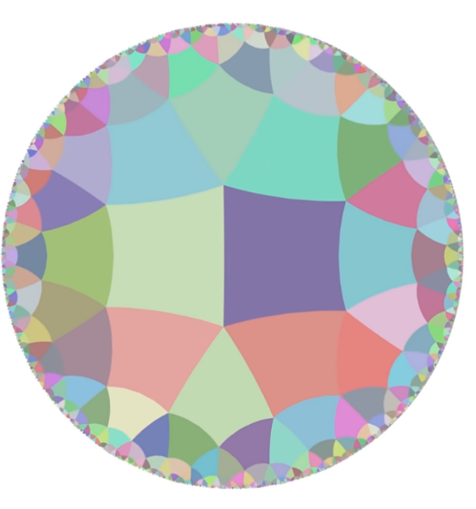
Non-Euclidean Games
Non-Euclidean games are games that try to trick players’ perspectives to make them believe they are in a non-Euclidean environment. These games started to gain popularity in the last years and more game developers started developing new games in this area.
This is from a game called Hyperbolica, where each corner has 5 squares connected to it.

Slide 4
Problem
Even if non-Euclidean games are gaining popularity, there are no public projects with a purpose to help game developers develop non-Euclidean games.
But there are many game developers that try to develop new non-Euclidean games using same features as their predecessors.

Slide 5
Goal
Because of the reasons we listed in our last slide, our goal is to create an addon for the popular game engine Unity, to provide a means to implement some common features of the non-Euclidean games to game developers.

Slide 6
Analysis
After researching existing games in this area, we stumbled upon two main features. Portals and areas that twist the camera of the game so that walls and objects look differently that they actually are to the players.
Portals provide utility to change the place of the player without them knowing it thus creating many opportunities to delude players’ perspective.
And areas that twist the perspective of the player actually imitates a non-Euclidean perspective, so that players’ actually thing they are in a non-Euclidean space.

Slide 7
Solution
Our solution was to provide these 2 features in an easy to use way. We will achieve this by using Unity’s interface and object customization features and providing pre-made prefabs and scripts that will be spawned from the add-on interface
Unity uses C# as its scripting language. So we will be using it to develop our add-on.

Slide 8
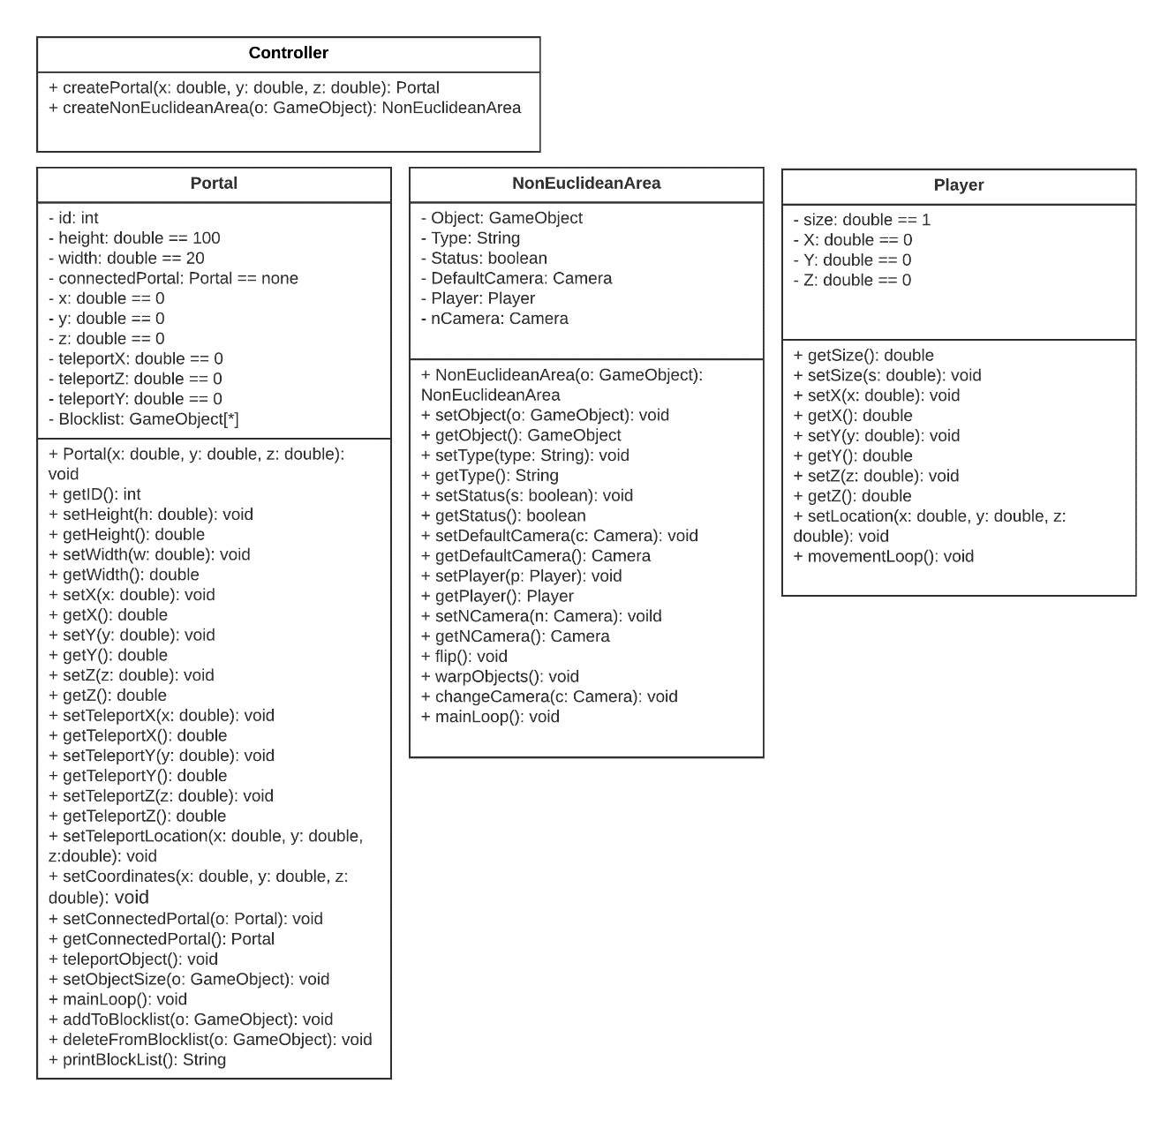
Class Diagram

Slide 9
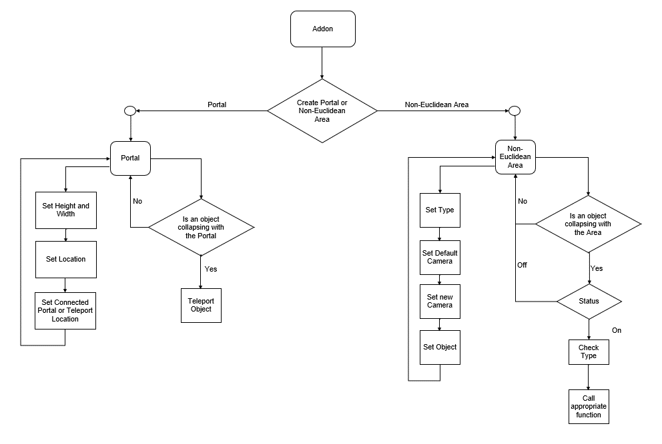
Flowchart
A flowchart to show how our add-on will work.

Slide 10
References
1] Studytonight.com. What Is A Game Engine? | Studytonight. [online] Available at: https://www.studytonight.com/3d-game-engineering-with-unity/game-engine [Accessed 6 November 2020].
[2] Guimarães, F. and Mello, V., 2015. Geometry Independent Game Encapsulation For Non-Euclidean Geometries. [ebook] Available at: https://www.visgraf.impa.br/Data/RefBib/PS_PDF/sib2015filipe/wip-filipe.pdf [Accessed 6 November 2020].
[3] Encyclopedia Britannica. Euclidean Geometry. [online] Available at: https://www.britannica.com/science/Euclidean-geometry [Accessed 6 November 2020].
[4] Encyclopedia Britannica. Non-Euclidean Geometry. [online] Available at: https://www.britannica.com/science/non-Euclidean-geometry [Accessed 6 November 2020].
[5] Steam. Hyperbolica. [online] Available at: https://store.steampowered.com/app/1256230/Hyperbolica/ [Accessed 6 November 2020].
[6] Youtube. Codeparade. [online] Available at: https://www.youtube.com/channel/UCrv269YwJzuZL3dH5PCgxUw [Accessed 6 November 2020].
[7] Youtube. 2020. Rendering Hyperbolic Spaces - Hyperbolica Devlog #3. [online] Available at: https://www.youtube.com/watch?v=pXWRYpdYc7Q [Accessed 6 November 2020].
[8] Youtube. 2020. Non-Euclidean Geometry Explained - Hyperbolica Devlog #1. [online] Available at: https://www.youtube.com/watch?v=zQo_S3yNa2w [Accessed 6 November 2020].
[9] Youtube. 2018. Non-Euclidean Worlds Engine. [online] Available at: https://www.youtube.com/watch?v=kEB11PQ9Eo8 [Accessed 6 November 2020].
[10] Steam. Antichamber. [online] Available at: https://store.steampowered.com/app/219890/Antichamber/ [Accessed 6 November 2020].
[11] Wikipedia. Stencil Buffer. [online] Available at: https://en.wikipedia.org/wiki/Stencil_buffer#:~:text=A%20stencil%20buffer%20is%20an,RAM%20of%20the%20graphics%20hardware [Accessed 6 November 2020].
[12] Youtube. 2020. How do non-euclidean games work? | Bitwise. [online] Available at: https://youtu.be/lFEIUcXCEvI?t=540 [Accessed 6 November 2020].
[13] Steam. Superliminal. [online] Available at: https://store.steampowered.com/app/1049410/Superliminal/ [Accessed 6 November 2020].
[14] Unity. Unity Platform | Unity. [online] Available at: https://unity.com/products/unity-platform [Accessed 6 November 2020].
[15] OpenGL. 2020. Opengl Overview. [online] Available at: https://www.opengl.org/about/ [Accessed 6 November 2020].

Slide 11

Any Questions?

